Slide 1
Data Structure Algorithms
Section 8 – binary Tree

Slide 2
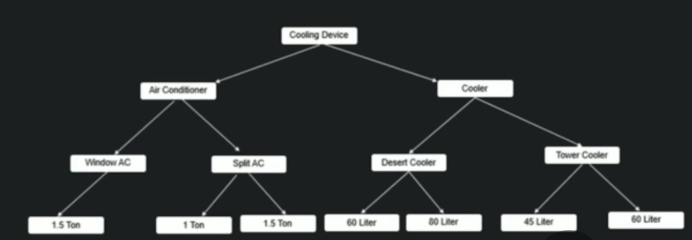
What is Tree?

Slide 3
What is Tree?
Properties of above Pic:
Used to represent data in hierarchical form.
Every node has 2 components (Data & Reference to its sub-category)
At top has Base product and 2 ‘products’ called Left sub-category and Right sub-category under it.

Slide 4
What is Tree?
Properties of Tree:
Used to represent data in hierarchical form.
Every Node(ideally) has 2 components (Data & Reference)
It has a Root node and 2 disjoin binary tree called left subtree and Right subtree.

Slide 5

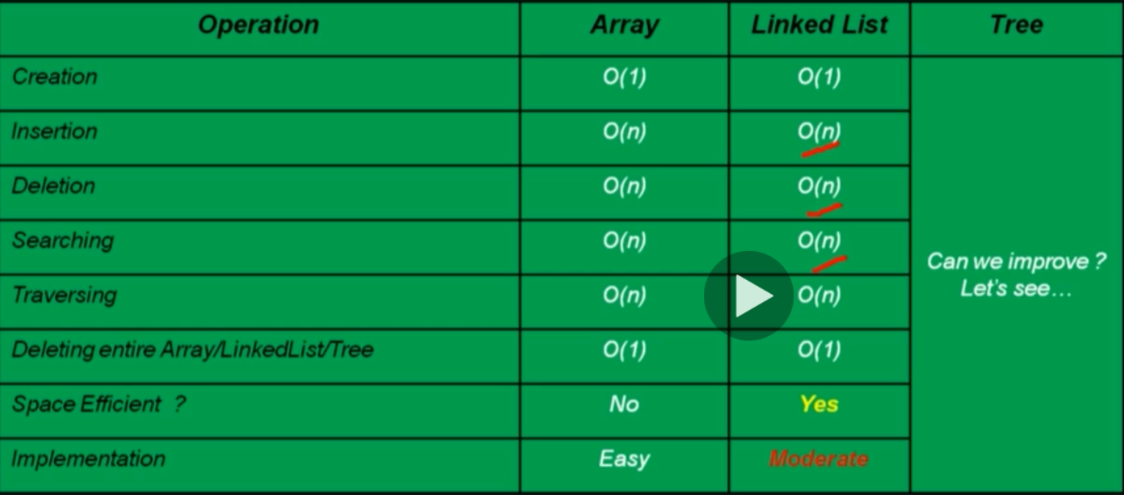
Why should we learn tree?

Slide 6
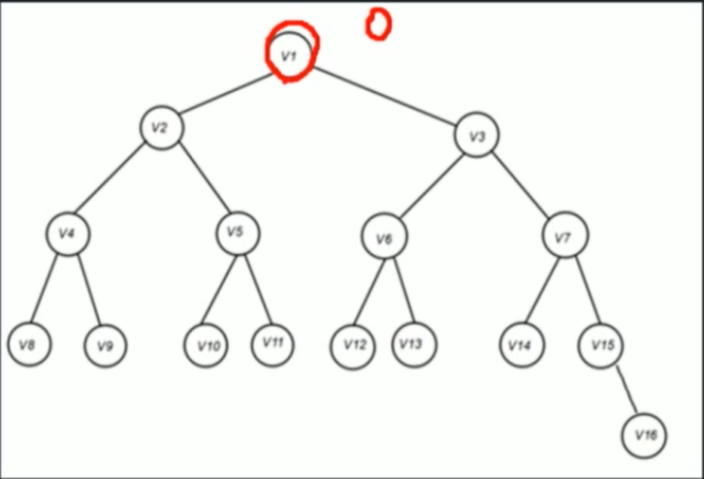
Tree Terminologies
Root: Node with no parent.
Edge: Link from Parent to Child.
Leaf: Node with no children.
Sibling: Children of same parent.
Ancestor: Means Parent, grand-Parent, great grand parent, and so on for a given node.
Depth of Node: Length of the path from root to node.
Height of Node: Length of the path from that node to the deepest node.
Height of tree: Same as height of Root node.
Depth of tree: Same as depth of Root node.

Slide 7
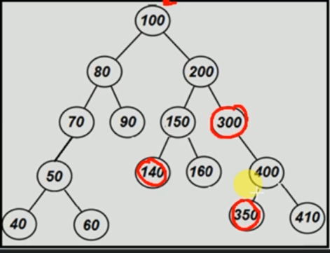
Tree Terminologies (continued …)
Predecessor: Predecessor of a node is the immediate previous node in order traversal of the Binary Tree.
Successor: Successor of a node is the immediate next node in order traversal of the Binary Tree.
In order Traversal – 40, 50, 60, 70, 80, 90, 100, 140, 150, 160, 200, 300, 350, 400, 410

Slide 8
Why should I learn tree?
Prerequisites for more advanced trees (BST, AVL, Red-Black, Expression Tree, etc …)
Is used in solving specific problems like:
Huffman Coding
Heap (Priority Queue)
Expressions parsing

Slide 9
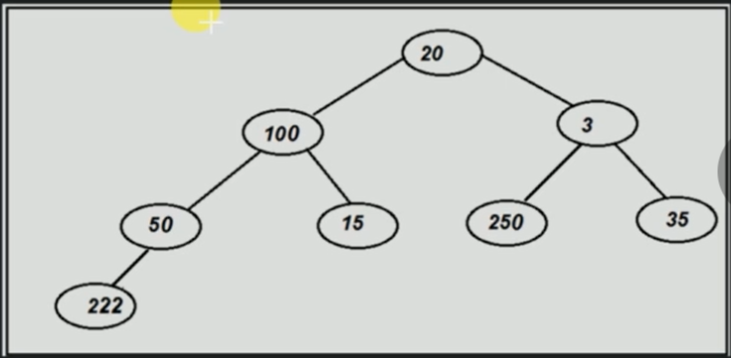
What is Binary Tree?
A tree is called as binary tree if each node has zero, one or two child.
It is a family of Data Structure (BST, Heap Tree, AVL, Red-Black, Syntax Tree, Huffman Coding Tree, etc.)
Example:

Slide 10
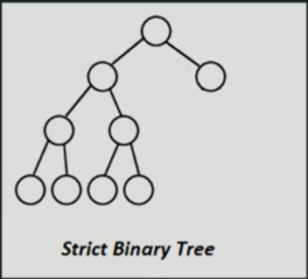
Types of Binary Tree
Strict Binary Tree: If each node has either 2 children or none

Slide 11
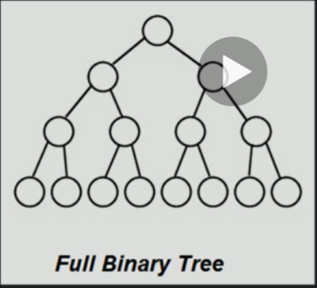
Types of Binary Tree
Full Binary Tree: If each non leaf node has 2 children and all leaf nodes are at same level.

Slide 12
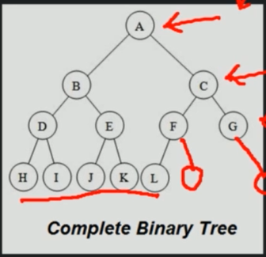
Types of Binary Tree
Complete Binary Tree: If all levels are completely filled excepted possibly the last level and the last level has all keys as left as possible.

Slide 13
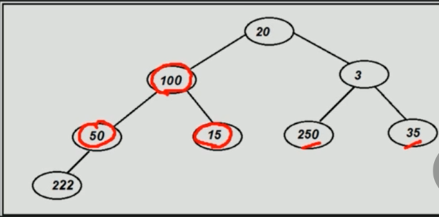
Tree Representation (Continued …)
How does tree looks like at logical level?

Slide 14
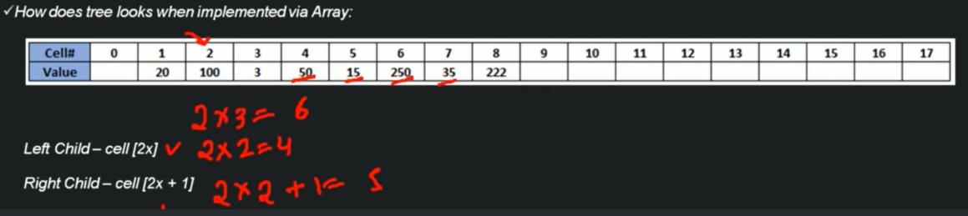
Tree Representation (Continued …)

Slide 15
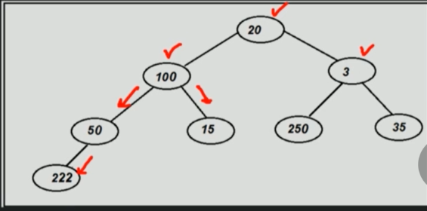
Tree Representation (Continued …)
How does tree looks like at logical level?

Slide 16
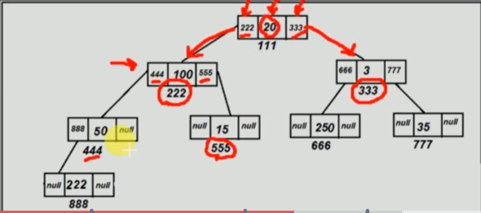
Tree Representation (Continued …)
How does tree looks when implemented via Linked List.

Slide 17
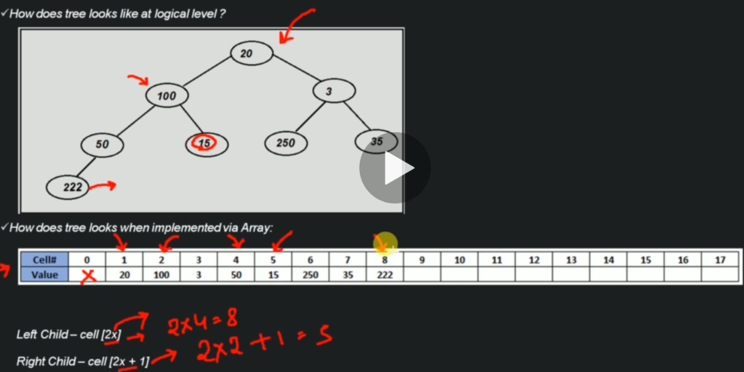
Binary Tree – Array Representation

Slide 18
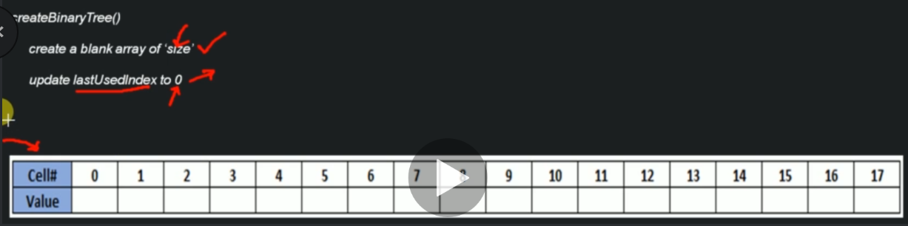
Algorithm – Creation of Binary Tree (Array Implementation)

Slide 19
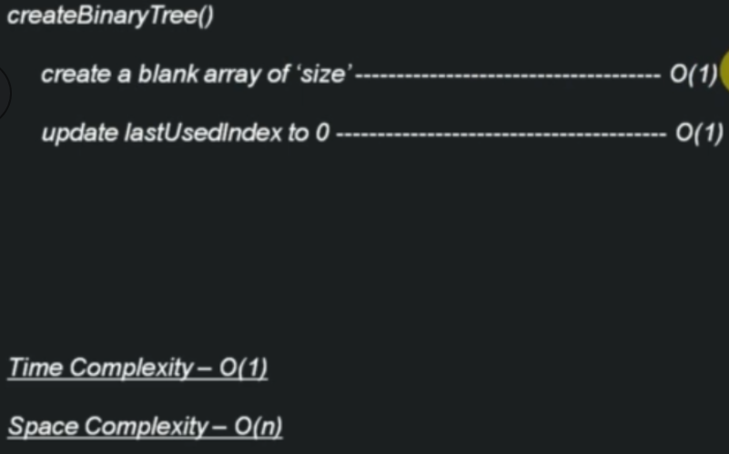
Time & Space Complexity – Creation of Binary Tree (Array Implementation)

Slide 20
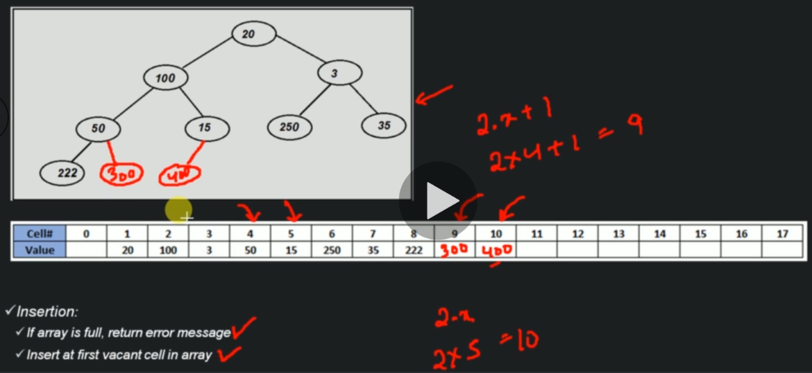
Insertion of node in Binary Tree ( Array Implementation )

Slide 21
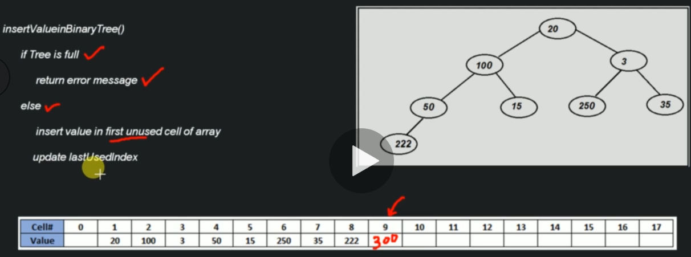
Algorithm - Insertion of node in Binary Tree ( Array Implementation )

Slide 22
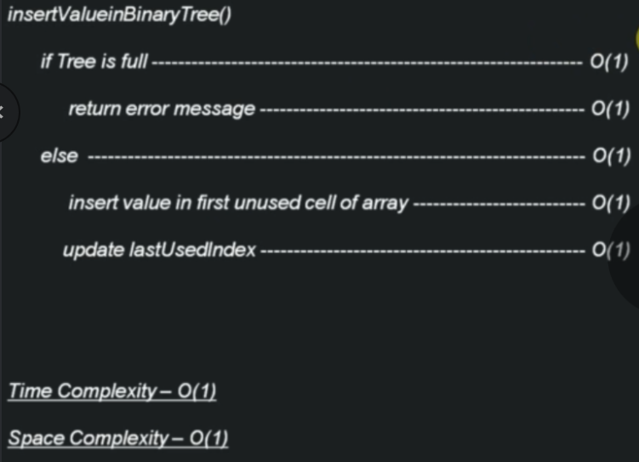
Time & Space Complexity - Insertion of node in Binary Tree ( Array Implementation )

Slide 23
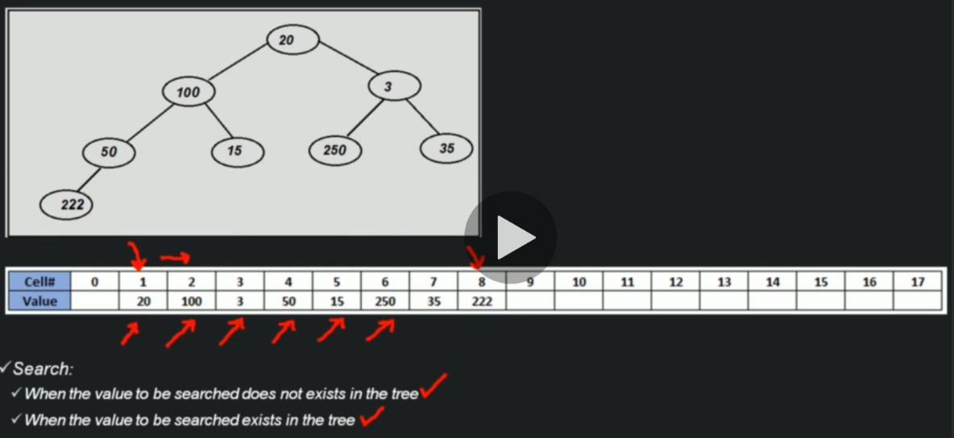
Searching a node in Binary Tree (Array Implementation)

Slide 24
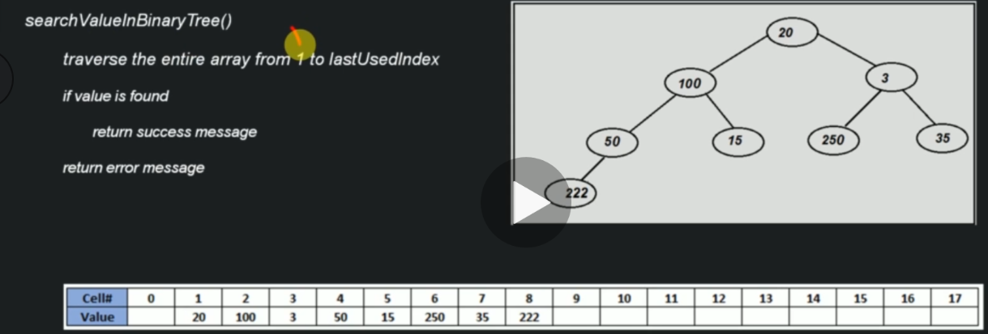
Algorithm - Searching a node in Binary Tree (Array Implementation)

Slide 25
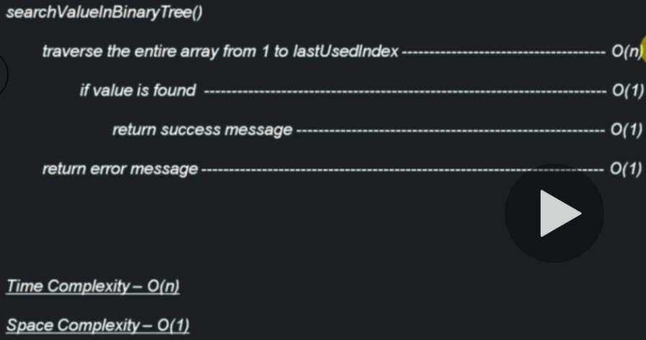
Time & Space Complexity - Searching a node in Binary Tree (Array Implementation)

Slide 26
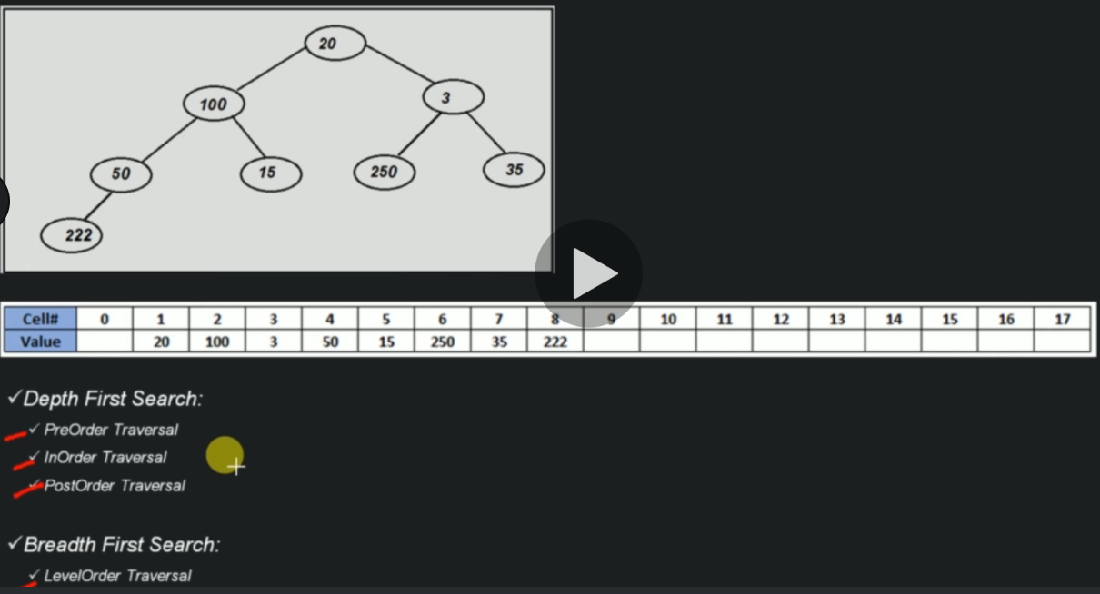
Traversing all nodes of Binary Tree (Array Implementation)

Slide 27
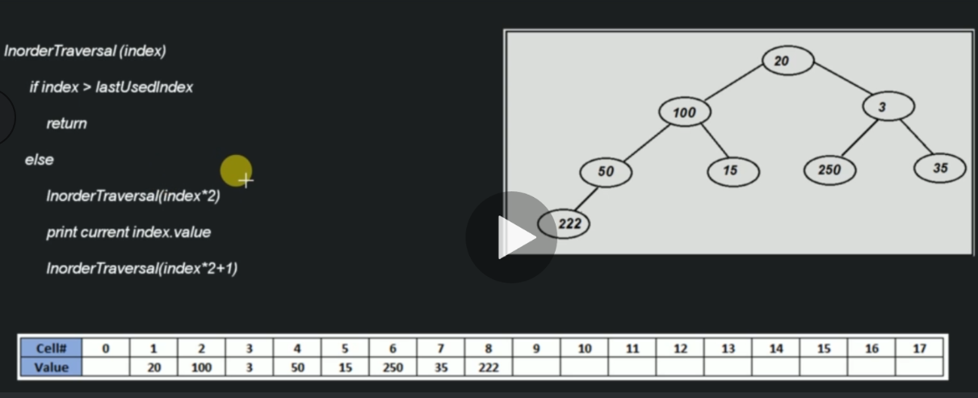
Algorithm (In-Order Traversal) of Binary Tree (Array Implementation)

Slide 28
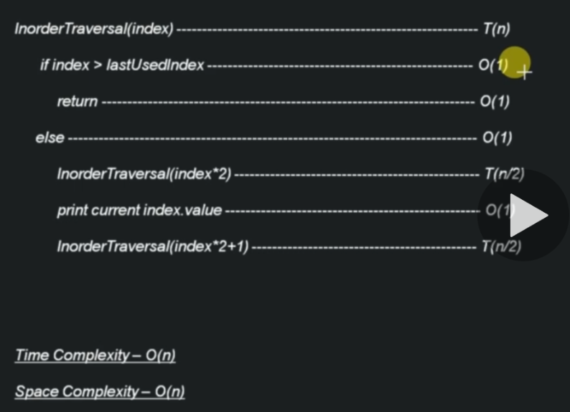
Time & Space Complexity (In-Order Traversal) of Binary Tree (Array Implementation)

Slide 29
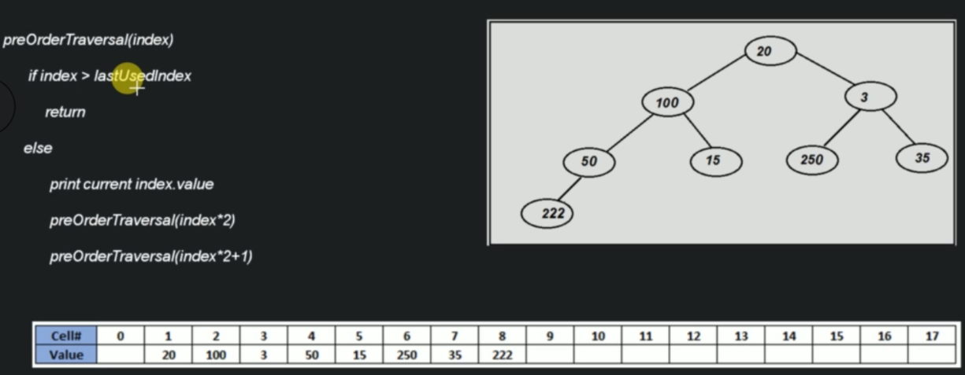
Algorithm (Pre-Order Traversal) of Binary Tree (Array Implementation)

Slide 30
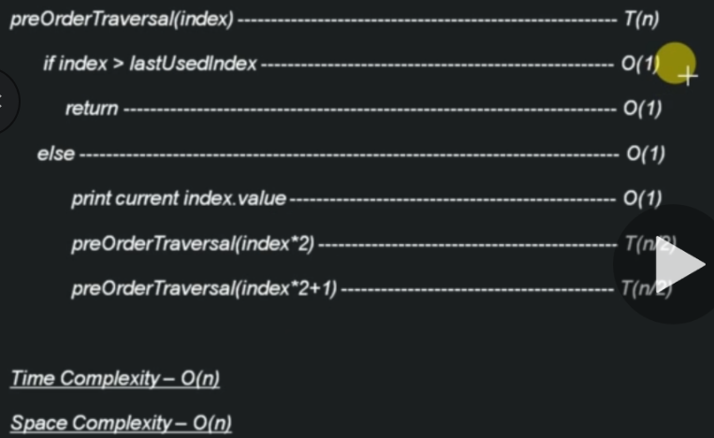
Time Space & Complexity (Pre-Order Traversal) of Binary Tree (Array Implementation)

Slide 31
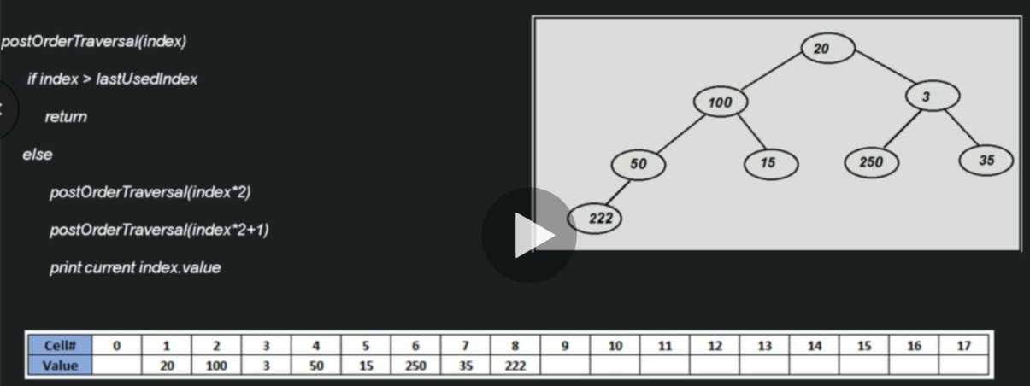
Algorithm(Post-Order Traversal) of Binary Tree (Array Implementation)

Slide 32
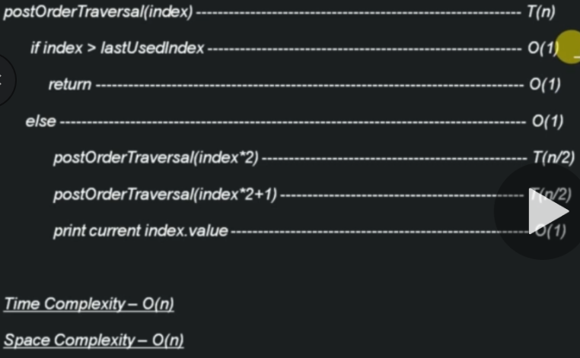
Time & Space Complexity - (Post-Order Traversal) of Binary Tree (Array Implementation)

Slide 33
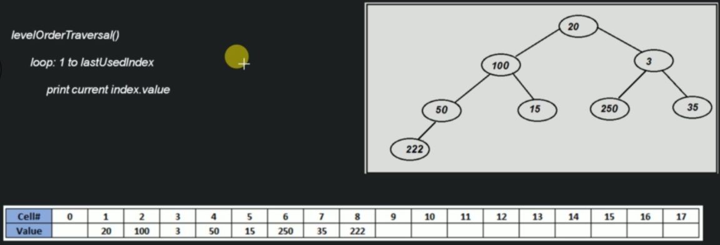
Algorithm ( Breadth First / Level Order Traversal ) of Binary Tree (Array Implementation)

Slide 34
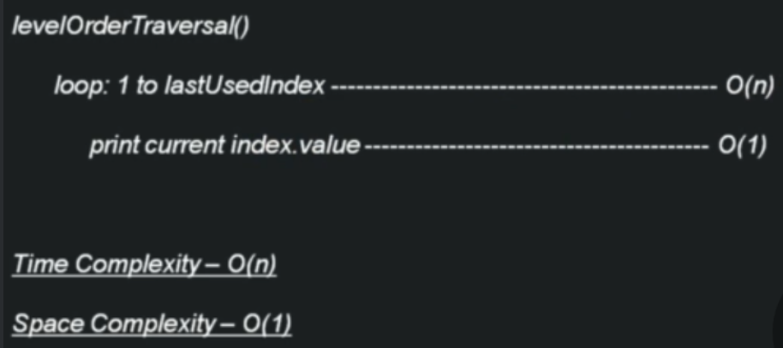
Time & Space Complexity ( Breadth First / Level Order Traversal ) of Binary Tree (Array Implementation)

Slide 35
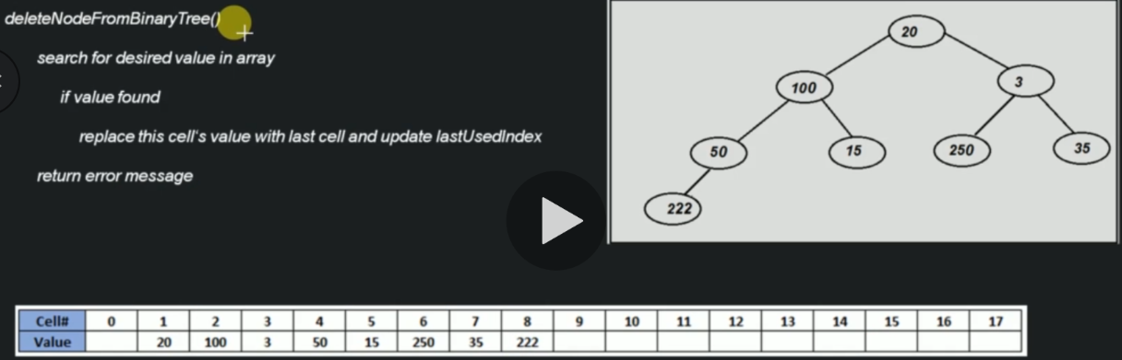
Algorithm – Deletion of node from Binary Tree (Array Implementation)

Slide 36
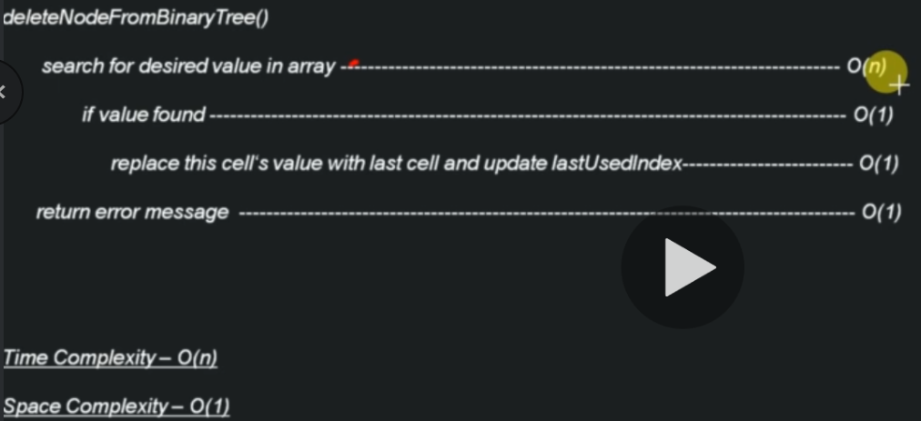
Time & Space Complexity – Deletion of node from Binary Tree (Array Implementation)

Slide 37
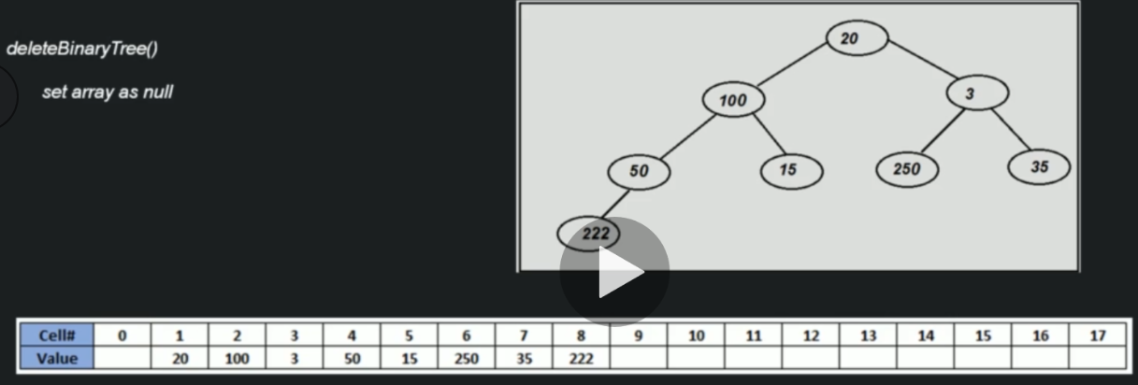
Algorithm – Delete Binary Tree (Array Implementation)

Slide 38
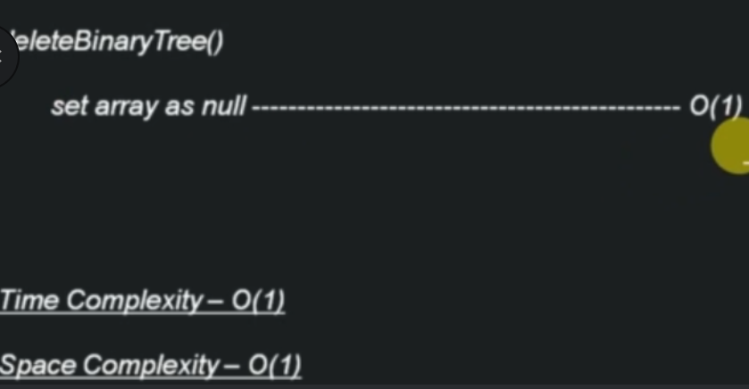
Time Space & Complexity – Delete Binary Tree (Array Implementation)

Slide 39
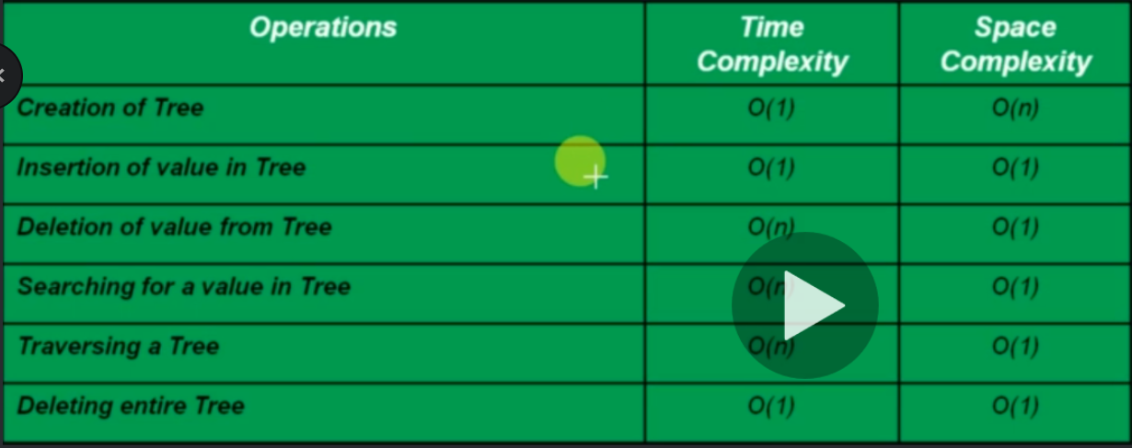
Time Space & Complexity –Binary Tree (Array Implementation)

Slide 40
Data Structure Algorithms
Section 8 – binary Tree ( linked list )

Slide 41
Algorithm - Creation of Binary Tree (Linked List Implementation)
createBinaryTree()
Create an object of Binary class

Slide 42
Time & Space Complexity - Creation of Binary Tree (Linked List Implementation)
createBinaryTree()
Create an object of Binary class ------- O(1)
Time Complexity - O(1)
Space Complexity - O(n)

Slide 43
Traversing all nodes of Binary Tree (Linked List Implementation)
Depth First Search:
PreOrder Traversal
InOrder Traversal
PostOrder Traversal
Breadth First Search:
LevelOrder Traversal

Slide 44
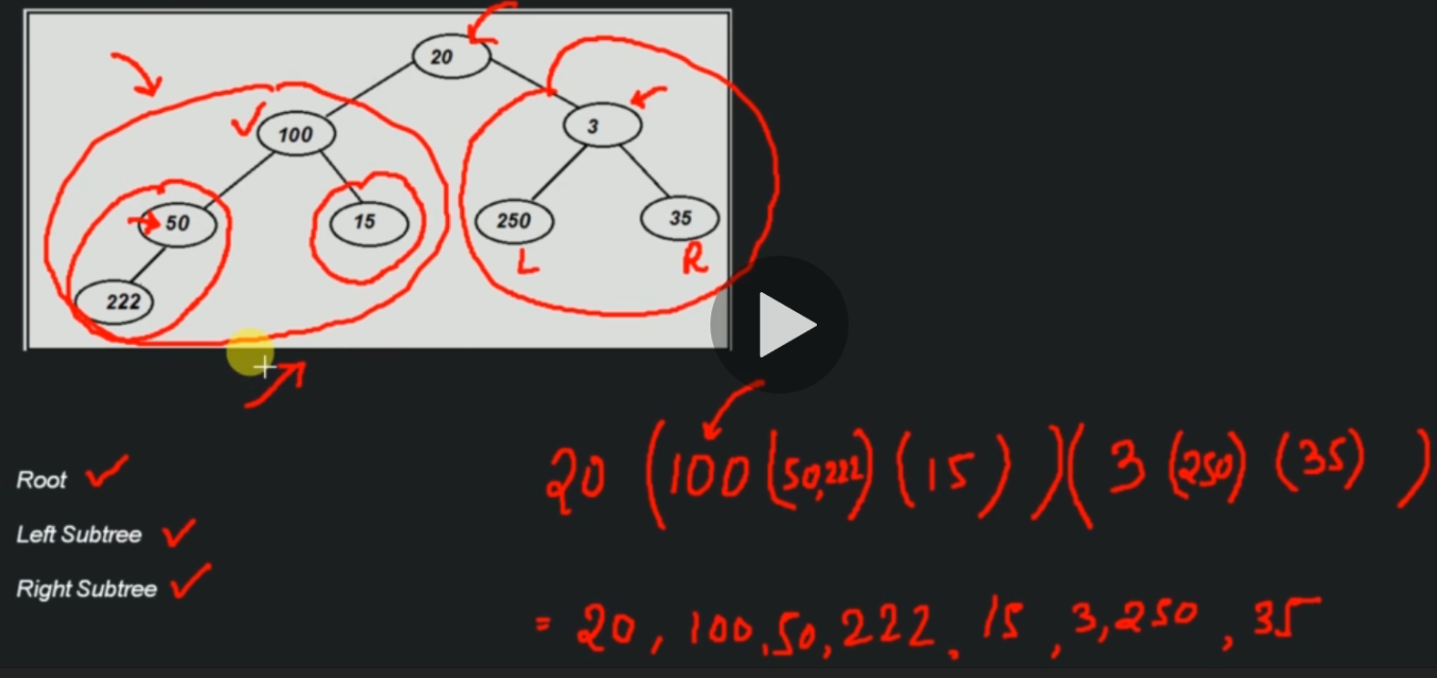
PreOrder Traversal (Linked-List Implementation )

Slide 45
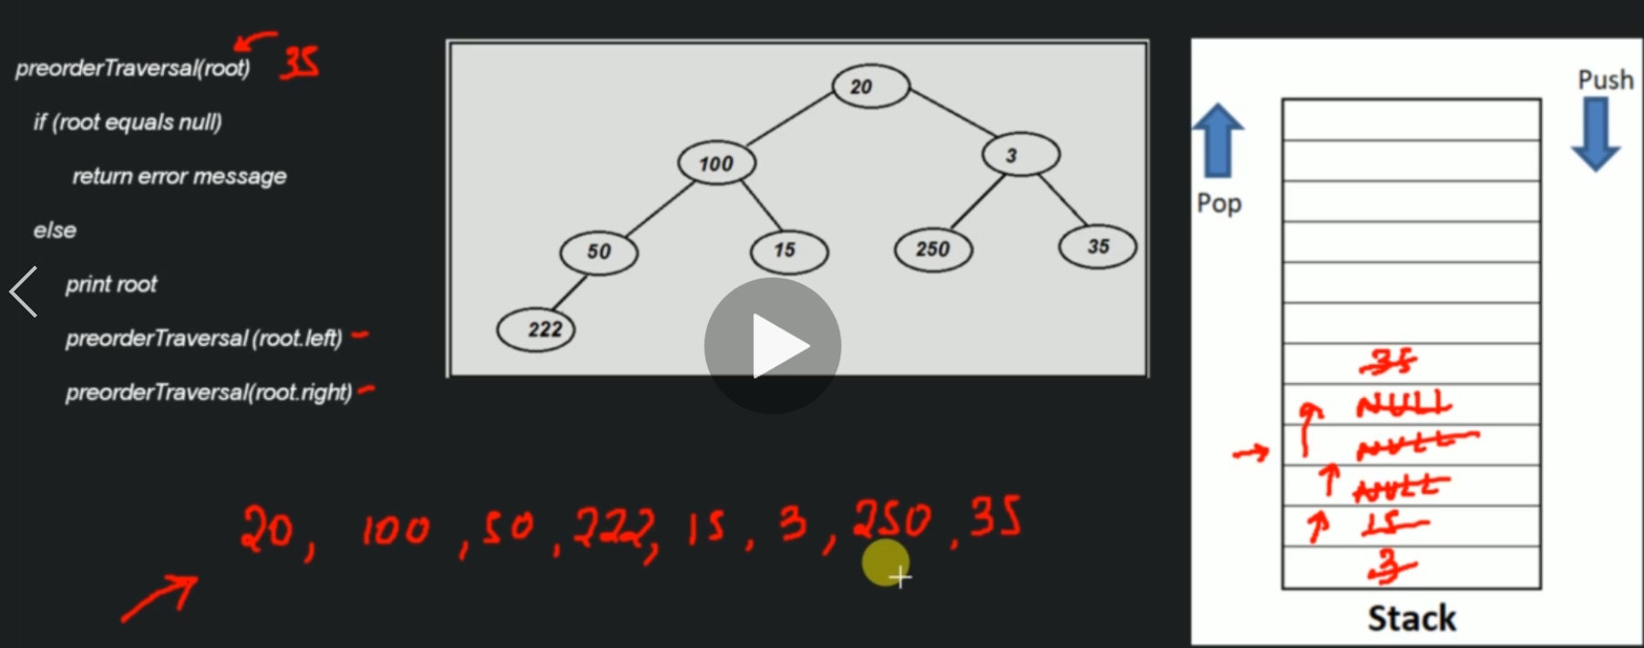
Algorithm - PreOrder Traversal (Linked-List Implementation

Slide 46
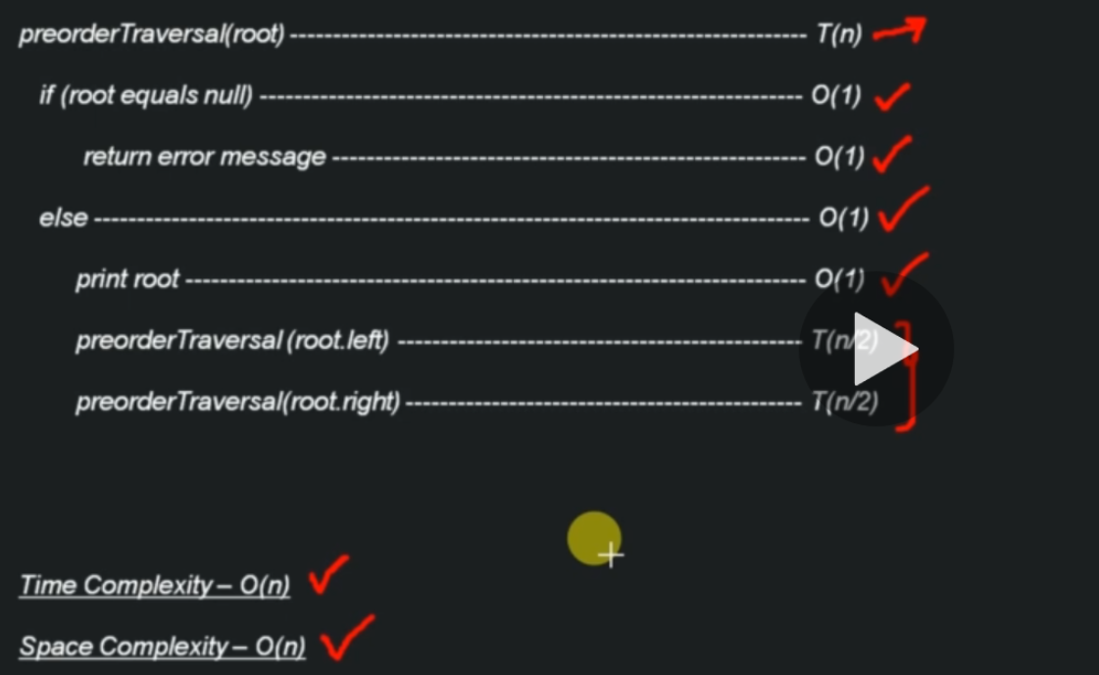
Time & Space Complexity - PreOrder Traversal (Linked-List Implementation

Slide 47
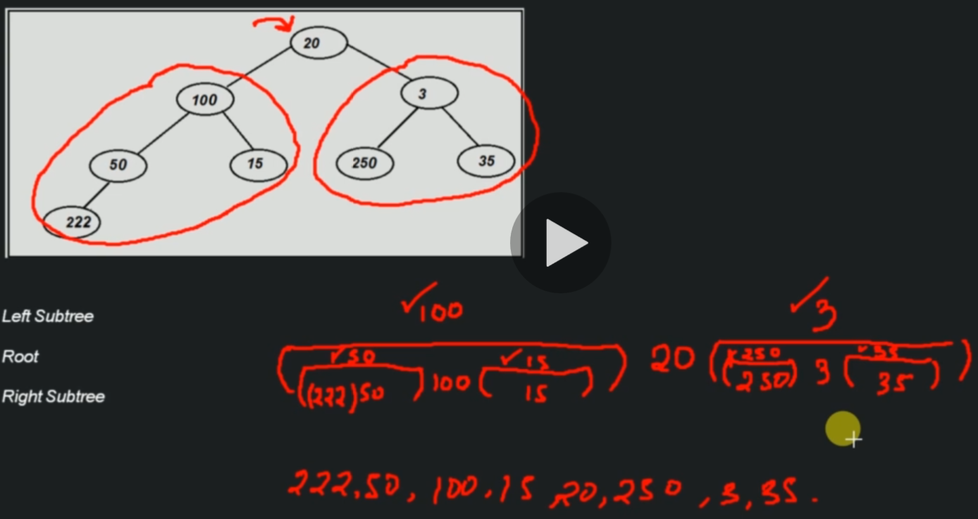
‘InOrder Traversal’ of Binary Tree (Linked-List Implementation

Slide 48
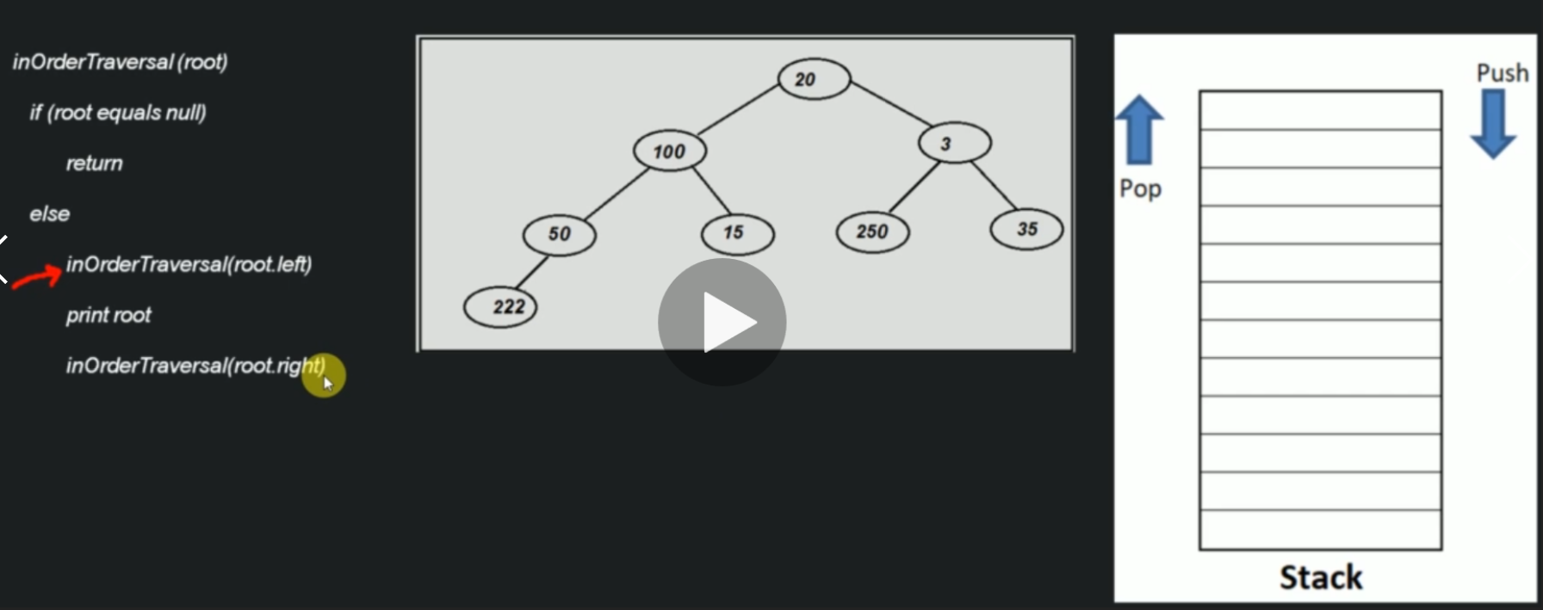
Algorithm – ‘InOrder Traversal’ of Binary Tree (Linked-List Implementation

Slide 49
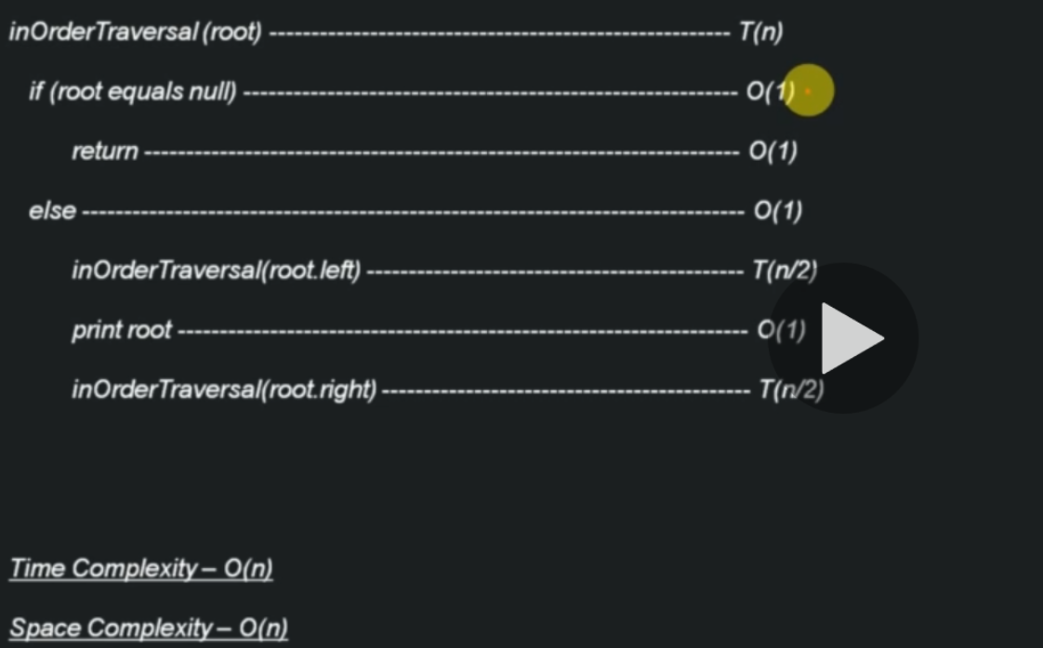
Time & Space Complexity – ‘InOrder Traversal’ of Binary Tree (Linked-List Implementation

Slide 50
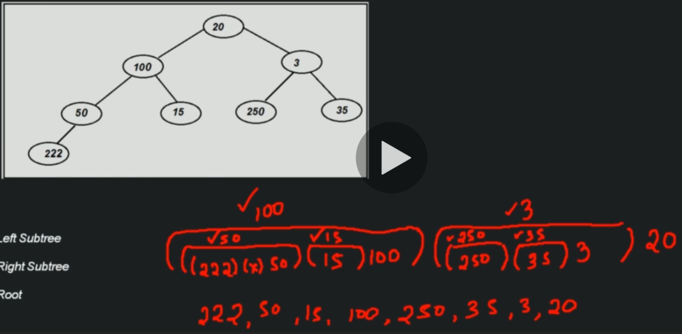
‘PostOrder Traversal’ of Binary Tree (Linked-List Implementation

Slide 51
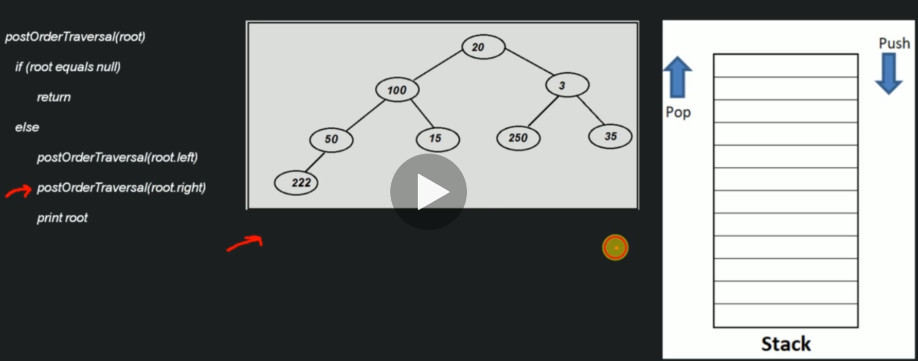
Algorithm – ‘PostOrder Traversal’ of Binary Tree (Linked-List Implementation

Slide 52
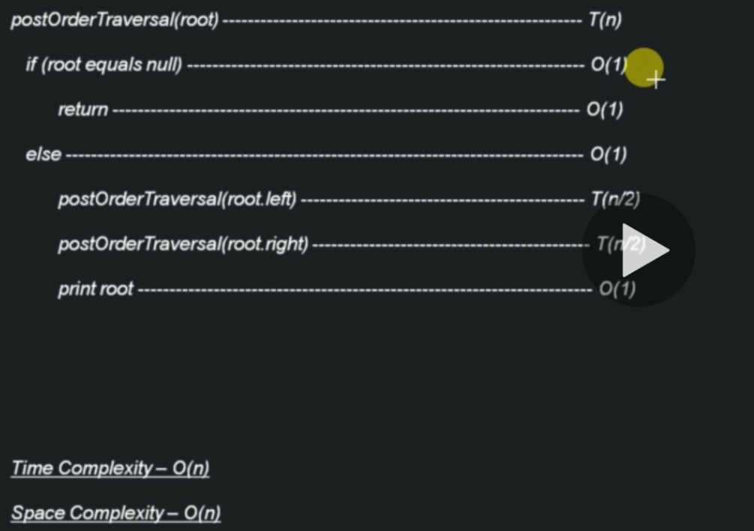
Time & Space Complexity – ‘PostOrder Traversal’ of Binary Tree (Linked-List Implementation

Slide 53
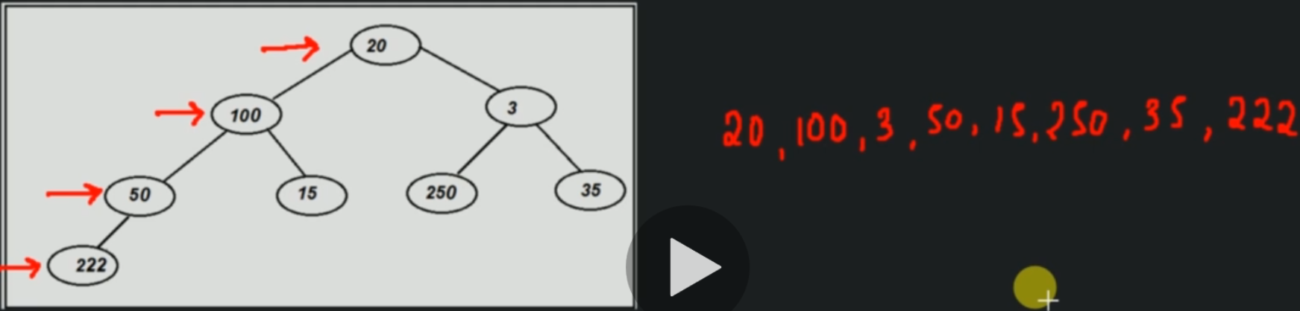
‘Level Order Traversal’ of Binary Tree (Linked-List Implementation

Slide 54
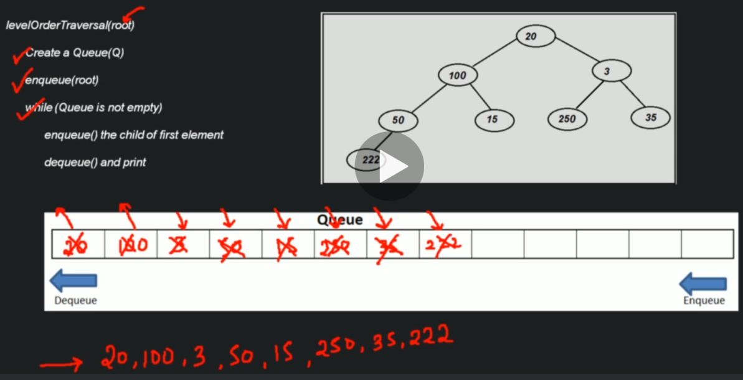
Algorithm – ‘Level Order Traversal’ of Binary Tree (Linked-List Implementation

Slide 55
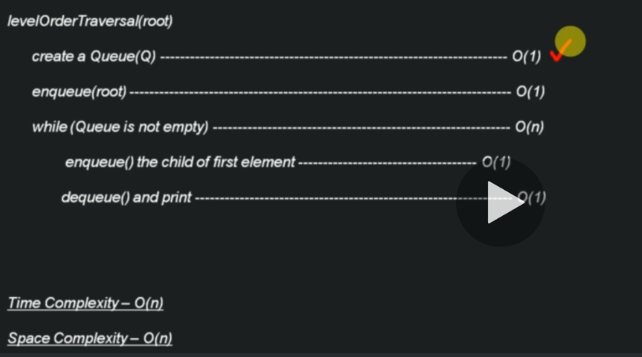
Time & Space Complexity – ‘Level Order Traversal’ of Binary Tree (Linked-List Implementation

Slide 56
Searching a node in Binary Tree (Linked List implementation)
Level Order Traversal Binary Queue is quicker to find a node than others because it uses queue rather than stack.

Slide 57
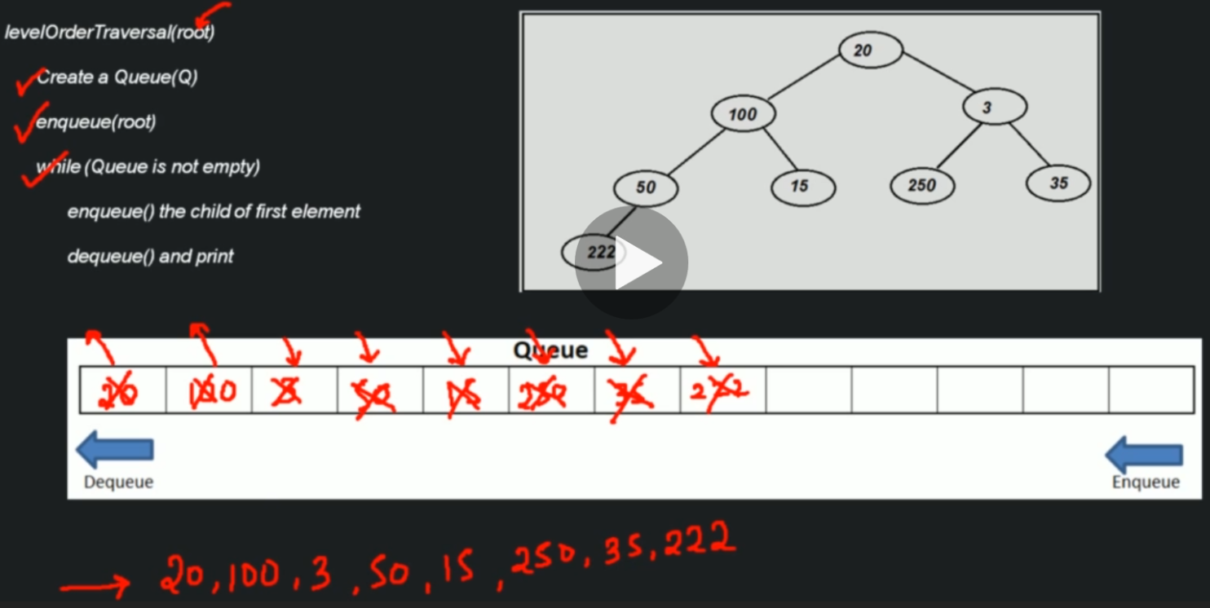
Algorithm - Searching a node in Binary Tree (Linked List implementation)

Slide 58
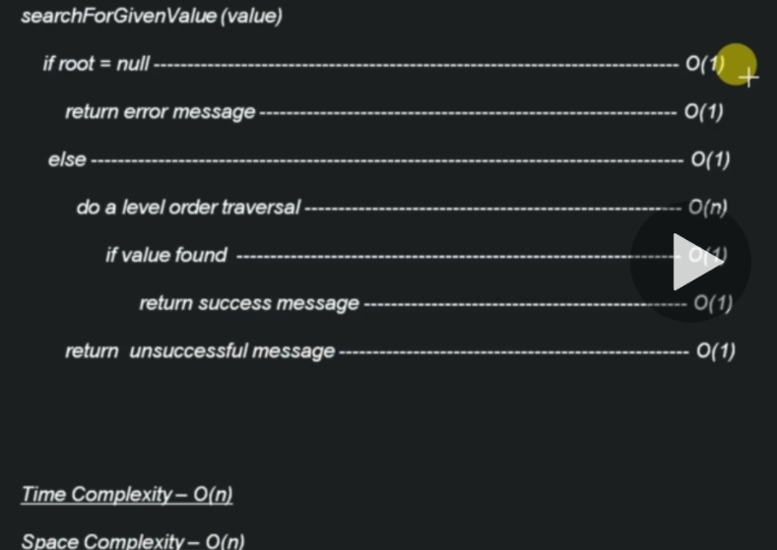
Time & Space Complexity - Searching a node in Binary Tree (Linked List implementation)

Slide 59
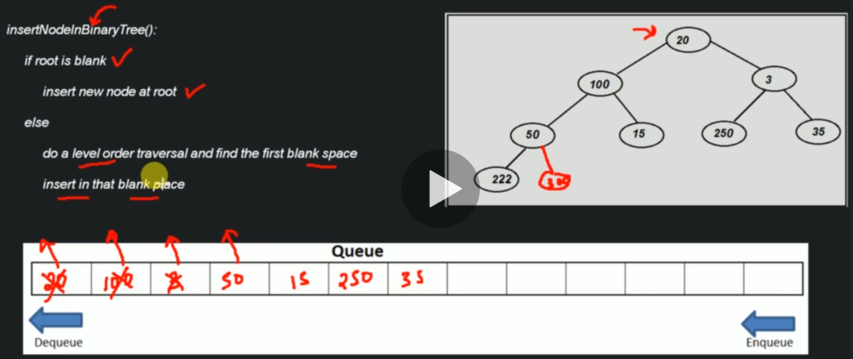
Algorithm – Insertion of node in Binary Tree (Linked List implementation)

Slide 60

Time & Space Complexity – Insertion of node in Binary Tree (Linked List implementation)

Slide 61

Delete of node in Binary Tree (Linked List implementation)

Slide 62

Algorithm - Delete of node in Binary Tree (Linked List implementation)

Slide 63

Time & Space Complexity - Delete of node in Binary Tree (Linked List implementation)

Slide 64

Algorithm - Delete Binary Tree (Linked List implementation)

Slide 65

Algorithm - Delete Binary Tree (Linked List implementation)

Slide 66

Time & Space Complexity Binary Tree (Linked List implementation)

Slide 67

Time & Space Complexity Binary Tree (Array vs Linked List implementation)

